Slide 1
Avalanche Prediction
To save people's life

Slide 2
What is Avalanche?
Avalanche means snow slide
Avalanche occurs when a slab of snow lying upon a weaker layer of snow fractures and slides down a steep slope

Slide 3
Types of Avalanche:
Wet Avalanches
Dry (Powder) Avalanches
Dry Slab Avalanches
Loose Snow Avalanches

Slide 4
Parameters:
Slope
Forest Density
Snow Density
Temperature
Wind

Slide 5
Slope:
It is measured in degree
Slope vs Avalanche
Slope in Degree | Level of Affecting
Less than 30 | low
30 to 40 | moderate
More than 30 | high

Slide 6
Forest Density:
Density | Level of affecting
Low | High
Medium | Medium
High | Low
It is described in three levels
Forest Density vs Avalanche

Slide 7
Snow Density:
It is measured in meters
Snow Density vs Avalanche
Snow Density in meter | Level of affecting
Less than 20 | Low
20-50 | Moderate
More than 50 | High

Slide 8
Temperature:
It is measured in Celsius
Temperature vs Avalanche
Temperature in celsius | Level of Affecting
Less than –10 degree More than 8 degree | High
Between –10 to 8 degree | Low

Slide 9
Wind:
It is measured in mph.
Wind vs Avalanche
Wind in mph | Level of affecting
Less than 10 | Low
11 to 22 | Moderate
More than 30 | High

Slide 10

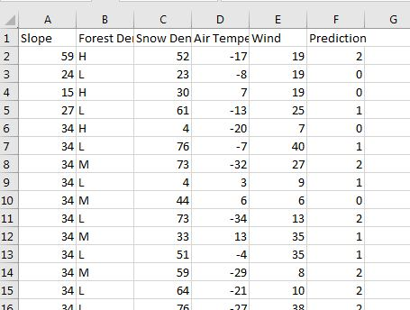
Sample Dataset:

Slide 11
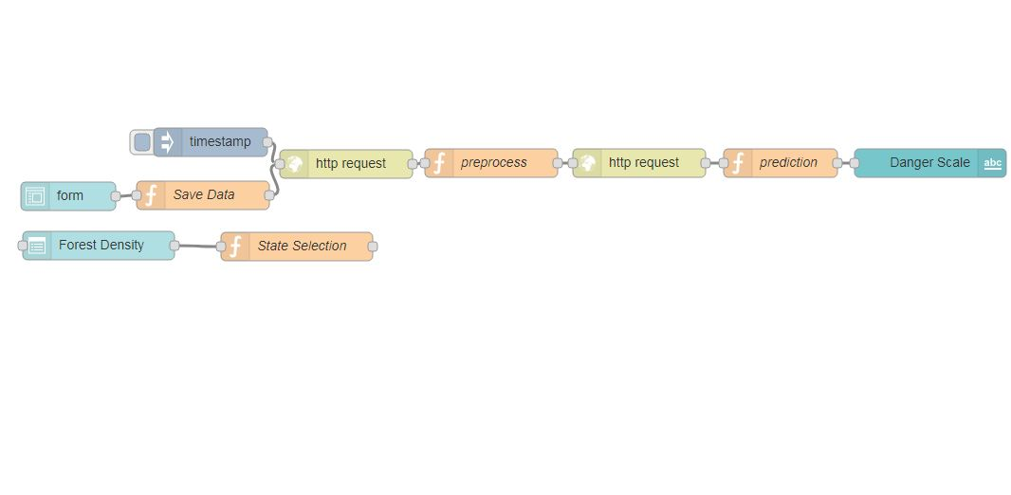
NodeRed Flow:

Slide 12

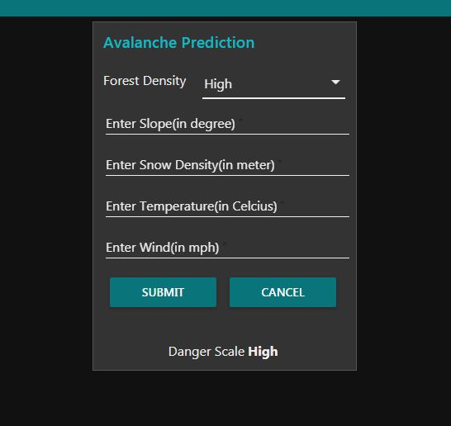



Our Website:
Url:https://arun8489.eu-gb.mybluemix.net/ui

Slide 13
Algorithm We Tried:
Algorithm | Accuracy Score
Decision Tree | 0.7804
Random Forest | 0.7317
Knn | 0.6097

